Slide 1

Semantic Web
A vision to achieve “Machine Understandable Web”

Slide 2
What is Semantic Web?
Semantic = meaning
Semantic web = meaning + web
= web
+ Database technology
+ Knowledge Representation
Extension of the current web
A web where the focus is placed on the meaning of words
A metadata based infrastructure

Slide 3
What is Semantic Web?
Semantic web is a group and technologies to allow machines to understand the meaning – or “Semantics” – of information on the World Wide Web.
The Semantic Web is an extension of the current web in which information is given well-defined meaning, better enabling computers and people to work in cooperation.“
The term was coined by World Wide Web Consortium(W3C) director Tim Berner-Lee.He defines the semantic web as “ A web of data that can be processed directly and indirectly by machines.”

Slide 4
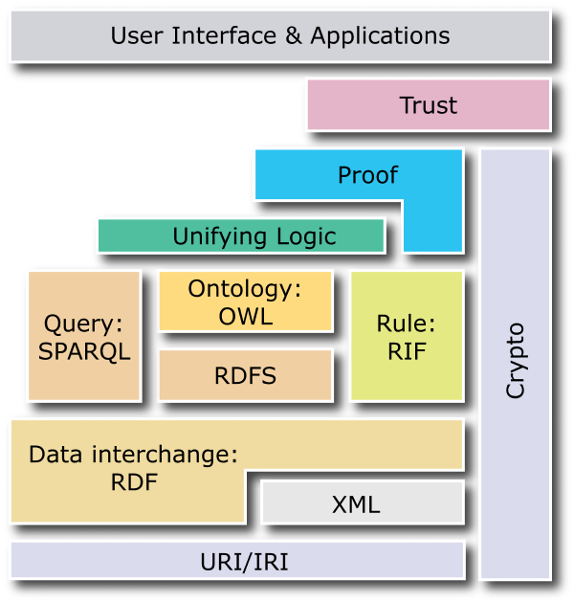
Semantic Web Vision
Machine-processable, global Web standards:
Assigning unambiguous names (URI)
Expressing data, including metadata (RDF)
Capturing ontologies (OWL)
Query, rules, transformations, deployment, application spaces, logic, proofs, trust (in progress)

Slide 5
Knowledge Representation
For Semantic Web to function, the Computers should have access to
  Structured Collection of information
  Meaning of this information
  Sets of Interface Rules/Logic
Technological Threads for developing Semantic Web:
  XML(Extensible Markup Language)
  RDF(Resource Description Framework)
  OWL(Web Ontology Language)

Slide 6
Extensible Markup Language(XML)
XML lets everyone to create their own tags.
These tags can be used by the script programs in sophisticated ways to perform various tasks, but the script writer has to know what the page writer uses each tag for.
In short, XML allows you to add arbitrary structure to the documents but says nothing about what the structures mean.
It has no built mechanism to convey the meaning of the user’s new tags to other users.

Slide 7
XML: limitations for semantic markup
XML representation makes no commitment on:
  Domain specific ontological vocabulary
    Which words shall we use to describe a given set of concepts?
  Ontological modelling primitives
    How can we combine these concepts, e.g. “car is a-kind-of (subclass-of) vehicle”
Requires pre-arranged agreement on vocabulary and primitives

Slide 8
XML is a first step
Semantic markup
  HTML ⇨ layout
  XML ⇨ content
Metadata
  within documents, not across documents
  prescriptive, not descriptive
  No commitment on vocabulary and modelling primitives
RDF is the next step

Slide 9
Resource Description Framework (RDF)
A schema for defining information on the web.It provides the technology for expressing the meaning of terms and concepts in a form that computers can readily process
RDF encodes this information on the XML page in sets of triples.The triples is an information on the web about related things.
Each triple is a combination of subject,verb and object,similar to an elementary sentence.

Slide 10
Resource Description Framework (RDF)
A standard of W3C
Relationships between documents
Consisting of triples or sentences:
  <subject, property, object>
  <“Mozart”, composed, “The Magic Flute” >
RDFS extends RDF with standard “ontology vocabulary”:
  Class, Property
  Type, subClassOf
  domain, range
Notes:
RDF is an XML application defined using a document type definition (DTD). A DTD was used because the design of RDF essentially pre-dates XML schema.
RDF is made up of triples which are like simple grammatical sentences with a subject, a verb and an object (in that order). The subject and the verb will be a URI, the object may be a URI or may be a literal. A literal is a character string or other primitive datatype defined by XML.
The uniqueness of the URI convention prevents confusion. Frequently the URI will be a URL where information about the data is stored. E.g. if I want to represent myself (Paul Warren) uniquely then I can create a URL somewhere (with a reasonable chance of guaranteeing persistence). The URL may have a descriptive identifier, e.g. …johnDavies.htm - but this is merely incidental. The page pointed at should preferably say something about the fact that the URL represents me. What we do require is that the URL be persistent.
Someone else, e.g. the tax office, may construct a URI representing me, and all the intelligent agents in the world will be blissfully ignorant that the two URIs refer to the same person … until a human intervenes and defines an equivalence between them.
Besides URLs, other forms of URI include identification of electronic mailboxes.

Slide 11
RDF for semantic annotation
RDF provides metadata about Web resources
Object -> Attribute-> Value triples
It has an XML syntax
Chained triples form a graph
http://sepang.nottingham.edu.my/~bpayam/images/payam-barnaghi.png
has_image
http://sepang.nottingham.edu.my/~bpayam/#Payam
UNiM
has_email
payam@nottingham
#Payam
has_owner
has_teaching
http://www.nottingham.edu.my/CSIT/G53ELC
Notes:
RDF has reification. Graph data model, property-centric approach.

Slide 12
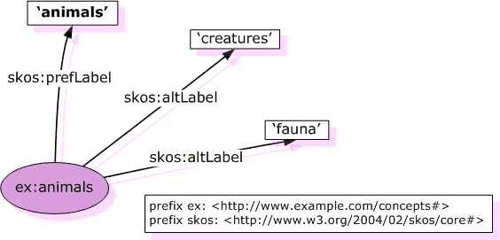
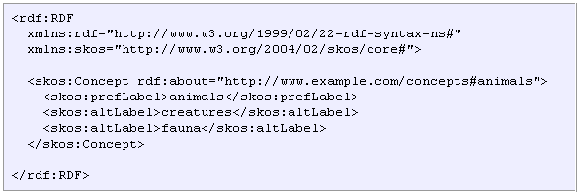
RDF Example
Source: http://www.w3.org/TR/swbp-skos-core-guide/

Slide 13
What is an Ontology?
A formal specification that provides sharable and reusable knowledge representation
  Examples: taxonomies, thesauri, topic maps, formal ontologies
An ontology specification includes:
  Description of the concepts in some domain and their properties
  Description of the possible relationships between concepts and the constraints on how the relationship can be used
  Sometimes, the individuals(members of concepts)

Slide 14
Web Ontology Language(OWL)
More expressive than RDF
  Identity equivalence/difference
More expressive class definitions
  Class intersection, union, complement, disjointness
  Cardinality restrictions
More expressive property definitions
  Object/Datatype properties
  Transitive, functional, symmentric, inverse properties
  Value restrictions

Slide 15
Web Ontology Language(OWL)
What can be done with OWL?
  Consistency checks - are there contradictions in the logical model?
  Satisfiability checks – are there classes that cannot have any instances?
  Classification – what is the type of a particular instance?
OWL sublanguages
  OWL Lite: low expressiveness / low computational complexity
  OWL DL: high expressiveness / decidable & complete
  OWL Full: max expressiveness / no guarantees

Slide 16
A Sample Ontology
Object
is_a
Person
knows
Topic
described_in
Document
is_a
writes
Student
Researcher
Semantics
F-Logic
Ontology
is_a
subTopicOf
similar
Doktoral Student
Affiliation
PhD Student
PhD Student
F-Logic
Ontology
PhD Student
Rules
instance_of
T
similar
D
T
D
described_in
is_about
Tel
Affiliation
Affiliation
Siggi
P
writes
D
is_about
T
P
knows
T
+49 721 608 6554
AIFB
[Studer et al, 04]
16

Slide 17
Semantic Web Content: New “Users”
Applications
Agents

Slide 18
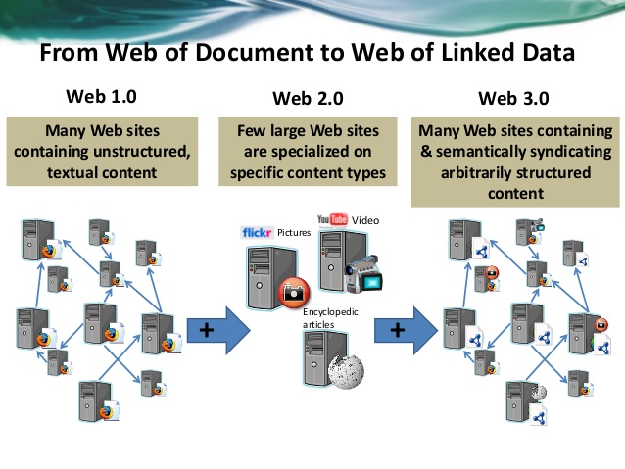
Web 1.0,2.0 and 3.0

Slide 19
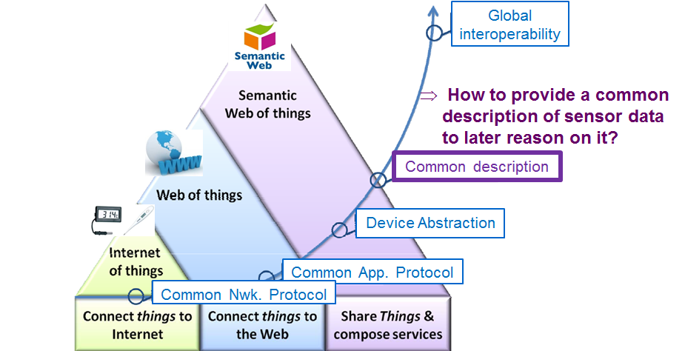
From Internet of Things to Semantic Web of Things

Slide 20
Advantages Of Semantic Web
Searches
Agents
Knowledge management
Integration
Virtual community
Machine dialogue across domain
Online advertising
Multimedia collection
Information Filtering
Serendipity

Slide 21
Disadvantages Of Semantic Web
The fact that the actual WWW is not compatible with the semantic web is a huge problem.
If a company decide to write its site in RDF,it won’t be readable by conventional web browsers.
The semantic web is fairly unknown and only few people know how to write a web page in RDF.

Slide 22
Conclusion
The semantic web in naming every concept simply by a URI, lets everyone express new concepts that they invent with minimal effort.
Its unifying modeling language will enable these concepts to be progressively linked into a universal web.
The structure of semantic web will open up the knowledge and workings of human kind to meaningful analysis by software agents, providing a new class of tools by which we can live, work and learn together.

